Slide 1




Slide 2
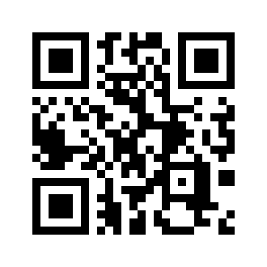
Deex Exchange in Telegram:
https://t.me/deexexchange

Slide 3
SEMI DECENTRALIZED
Ecosystem using
BITSHARES BLOCKCHAIN
Is the
REALITY
of decentralization

Slide 4
About the company and speaker
Graduate of the Higher School of Economics and the LSE
Experience on the processing market since 2004
Sberbank, Alfa-Bank, CyberPlat, QIWI, FLEXSOFT Company
Predprocessing company works on the market since 2010. We work with banks, housing and communal services, payment systems
Blockchain applications development and consulting
Representative of COINSBANK Co-founder of the IBCG community

Slide 5





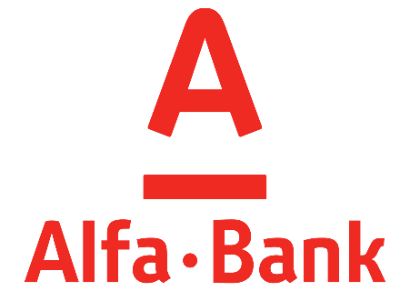
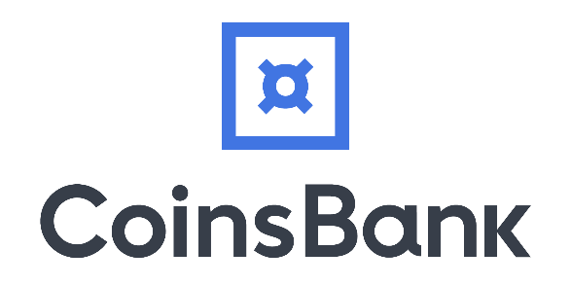


Slide 6
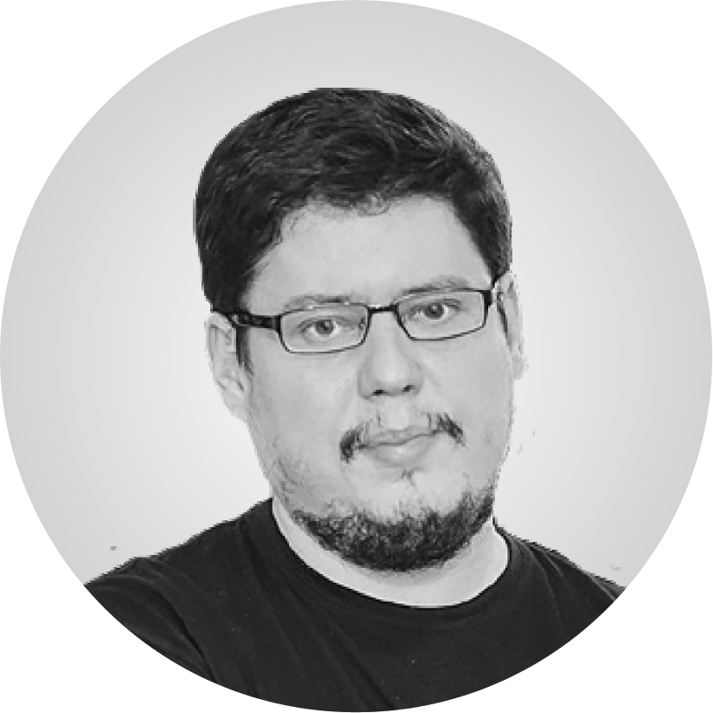
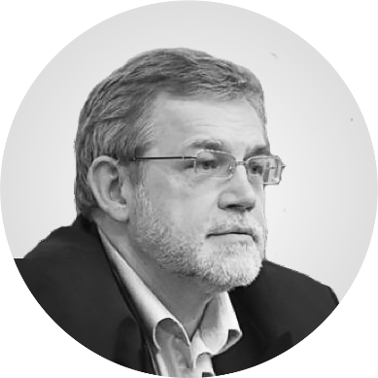
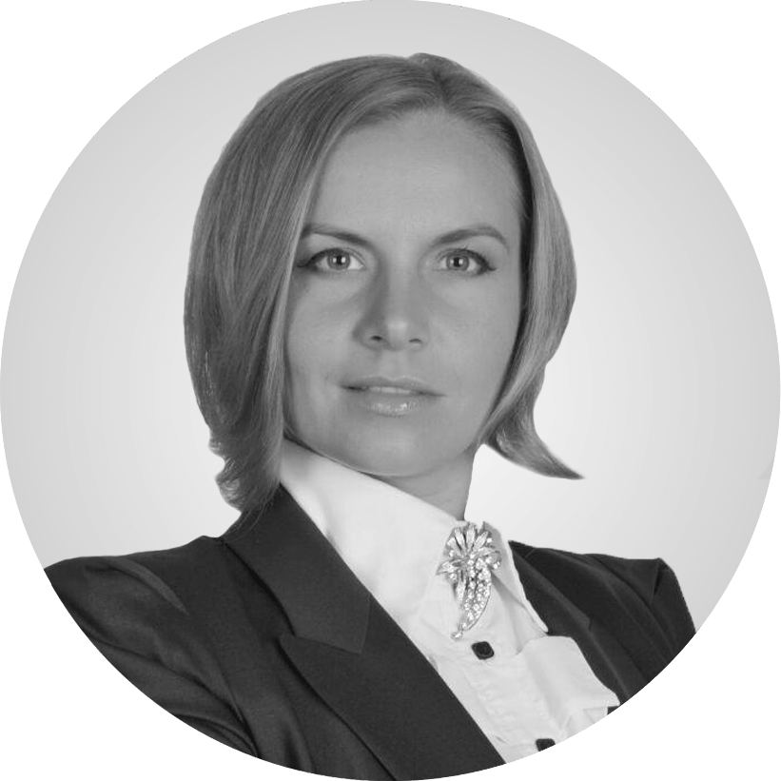
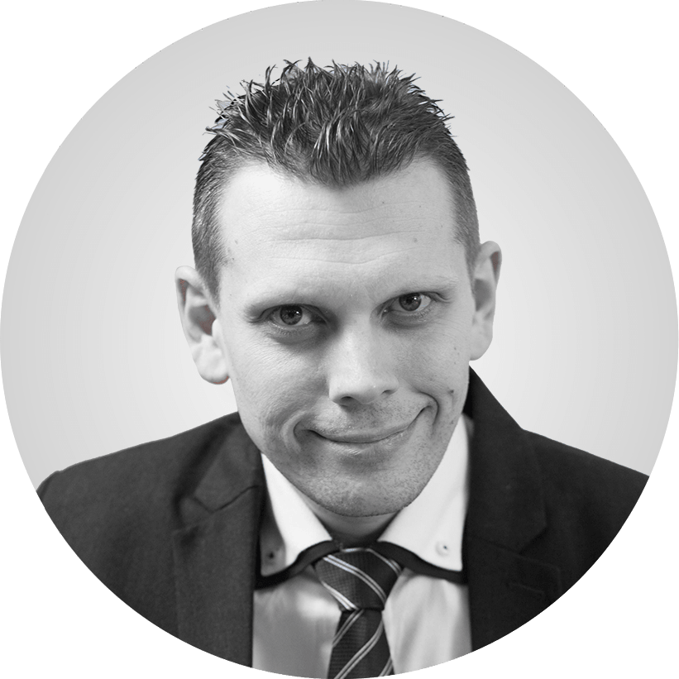
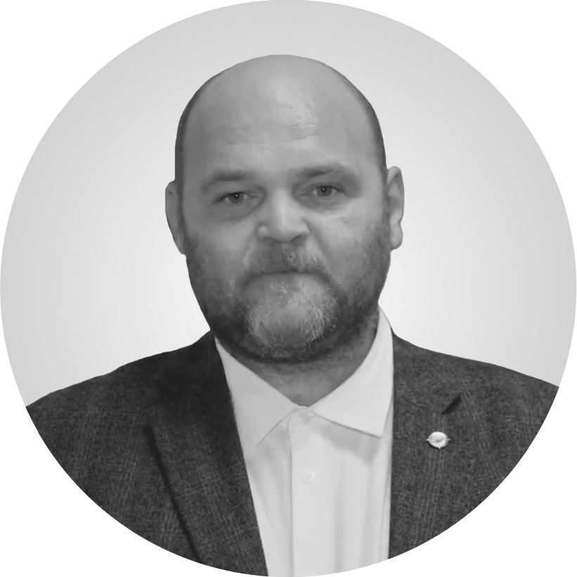
Vladislav Sapozhnikov
Yuri Milyukov
Maya
Zotova-Hess
Sergey Sevantsyan
Denis Soldatov

Slide 7
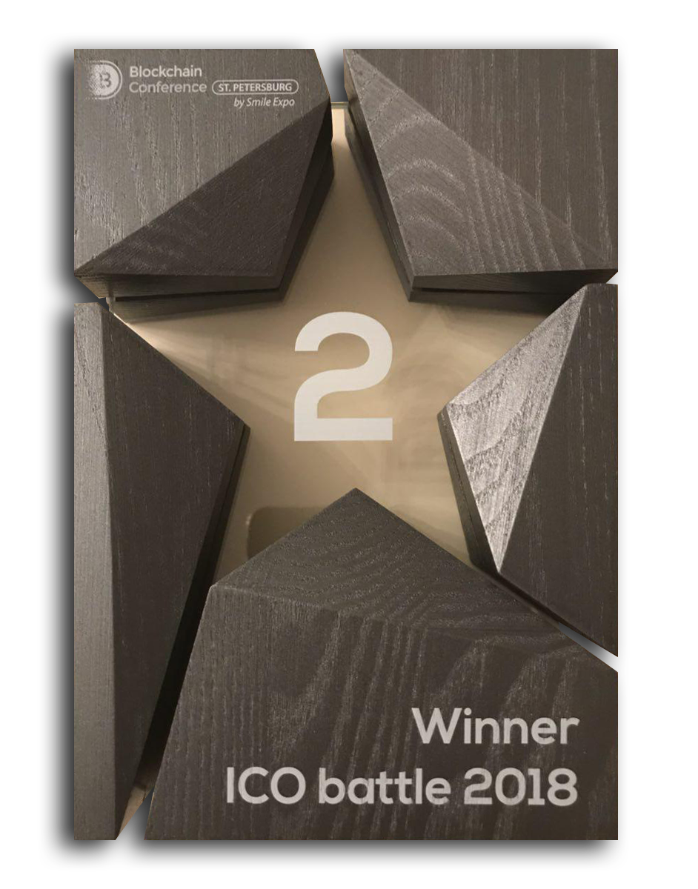

Winner of the ICO battle on the blockchain conference in
Russia

Slide 8
DECENTRALIZED
=
CENTRALIZED

Slide 9
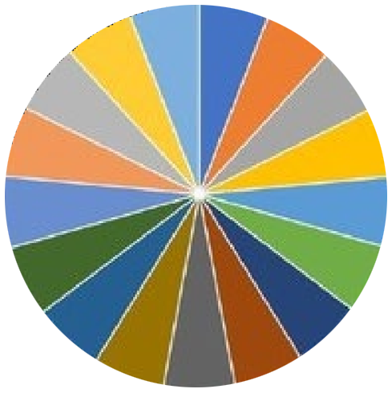
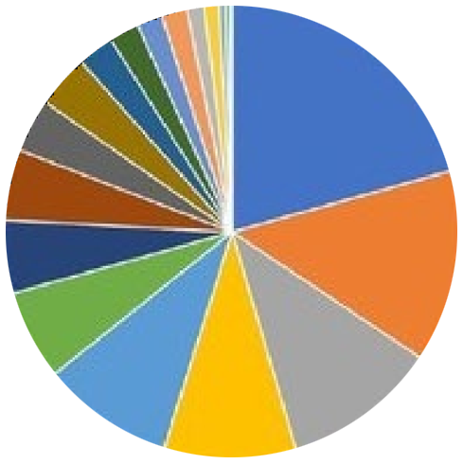
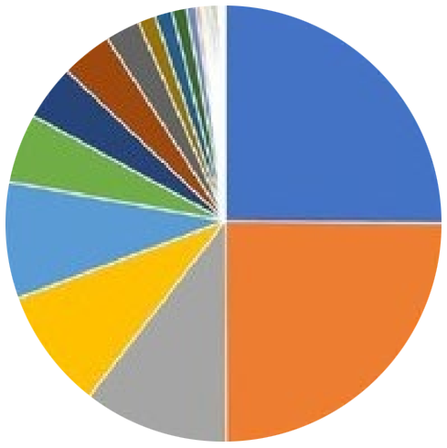
BITSHARES (DPOS)
BITCOIN (POW)
ETHEREUM (POW)

Slide 10

If you want something to get done, do it yourself.
2 WAYS of building the system:
- own blockchain with own consensus, or Graphene implementation (time and finance consuming, many risks and uncertainties)
- BTS fork (lack of liquidity)
- WORKING TOGETHER within one BTS ecosystem (we have both useful instruments for the community, as well as proposals for committee)
BEST FROM CENTRALIZED EXCHANGES ON
DECENTRALIZED PLATFORM

Slide 11
www.deex.exchange
BitShares Blockchain is about…
COOPERATION.
NOT
competition
BEST FROM CENTRALIZED EXCHANGES ON
DECENTRALIZED PLATFORM

Slide 12

www.deex.exchange
Decentralized Ecosystem on BitShares Blockchain
BEST FROM CENTRALIZED EXCHANGES ON
DECENTRALIZED PLATFORM

Slide 13
Problems with BTS ecosystem
Low liquidity
Sophisticated GUI
Lack of tools for technical analysis
Not very precise documentation
Small community
Lack of applications
Lack of marketing

Slide 14
www.deex.exchange
BitShares Blockchain is about…
COOPERATION and INTEGRATION.
NOT
competition
BEST FROM CENTRALIZED EXCHANGES ON
DECENTRALIZED PLATFORM

Slide 15


USERFRIENDLY INTERFACE

Slide 16

FAST TRANSACTIONS

Slide 17
TOKEN TO TOKEN TRADING

Slide 18
MANY ALTCOINS

Slide 19

CROWDFUNDING PLATFORM

Slide 20


CRYPTO ATMS

Slide 21








BLOCKCHAIN INVESTMENT FUND

Slide 22

THE SUM OF YOUR ACHIEVEMENTS

Slide 23
11 623 ETH
DEEX ICO
Around 12k users within 1 month
deex-faucet

Slide 24
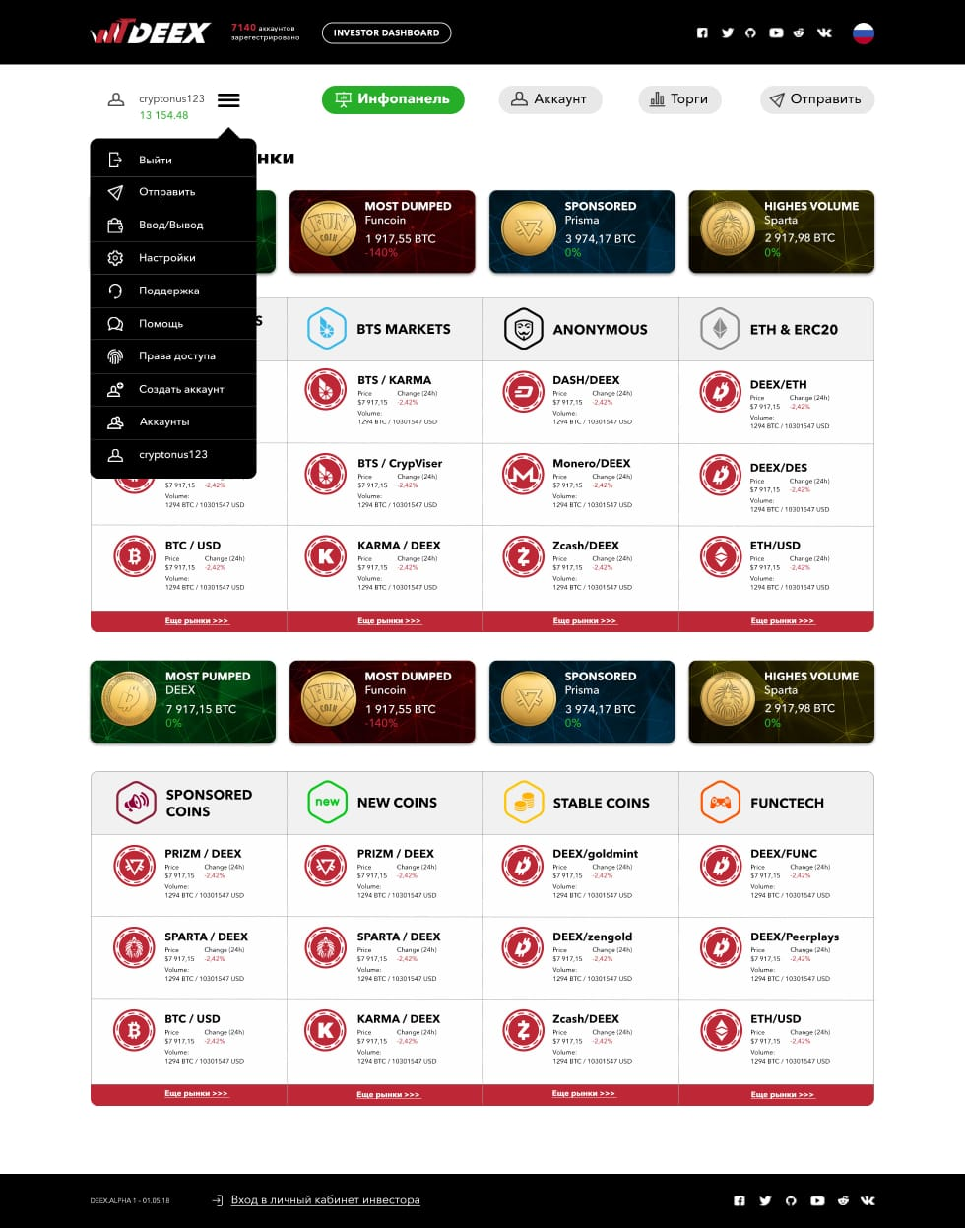
Faucet,
gateways,
front

Slide 25
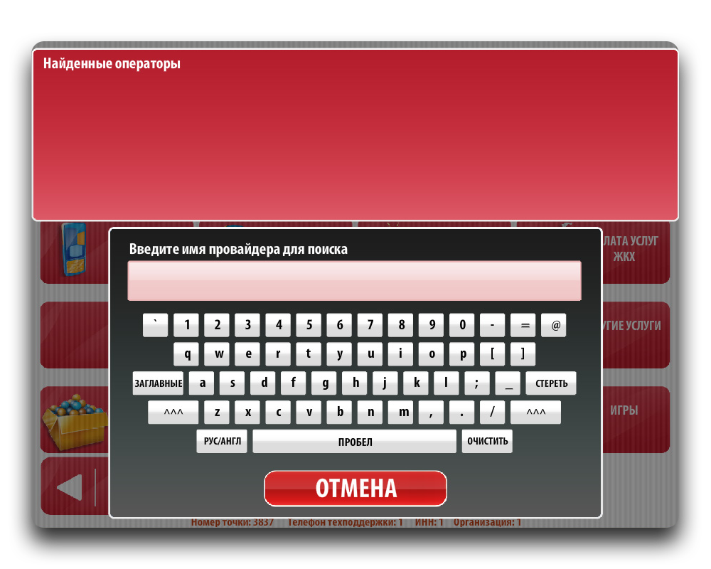
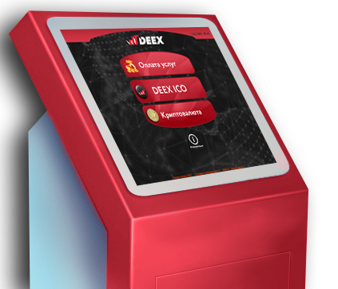
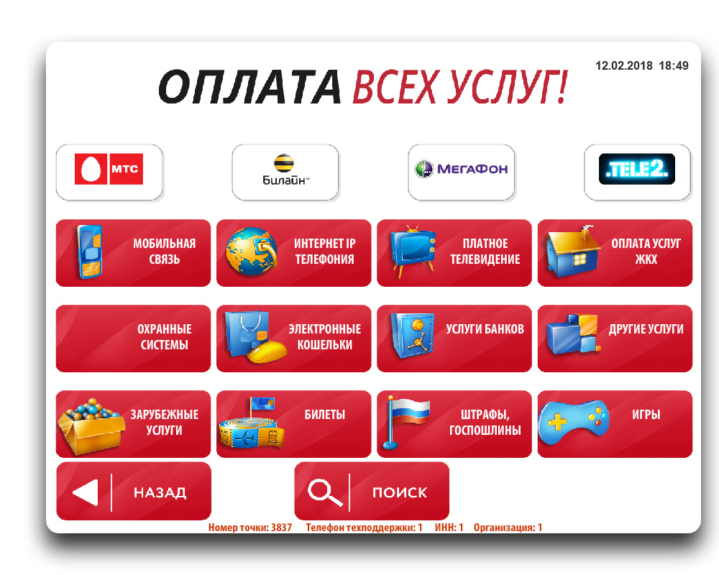
The ability to make payments for the most common services

Slide 26

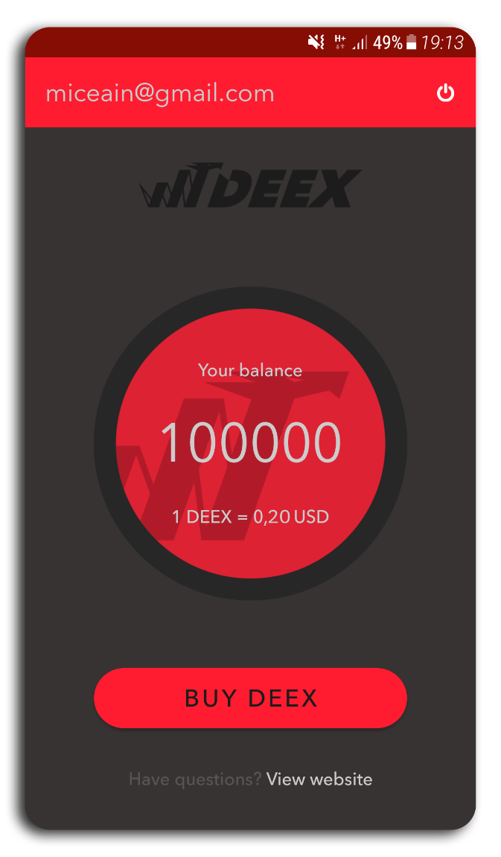
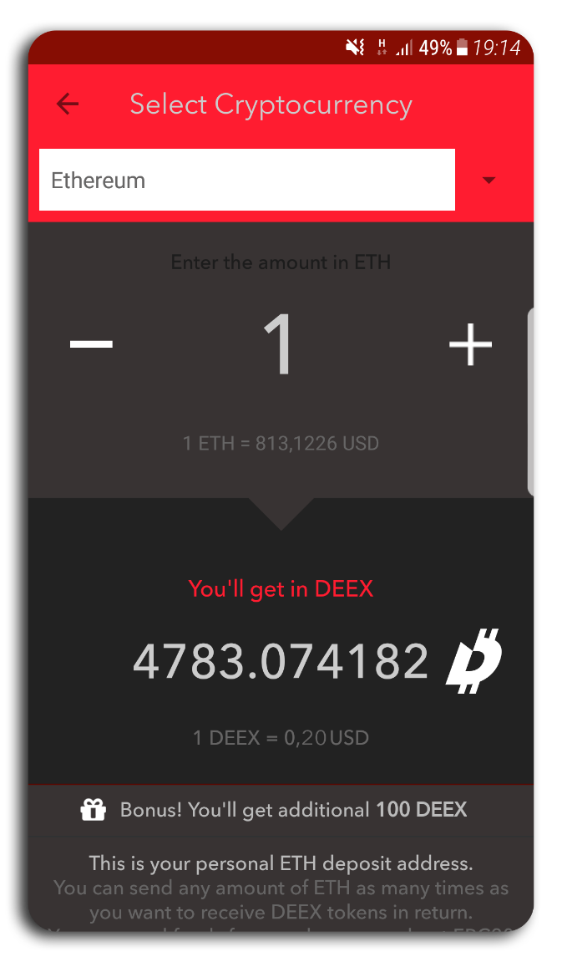
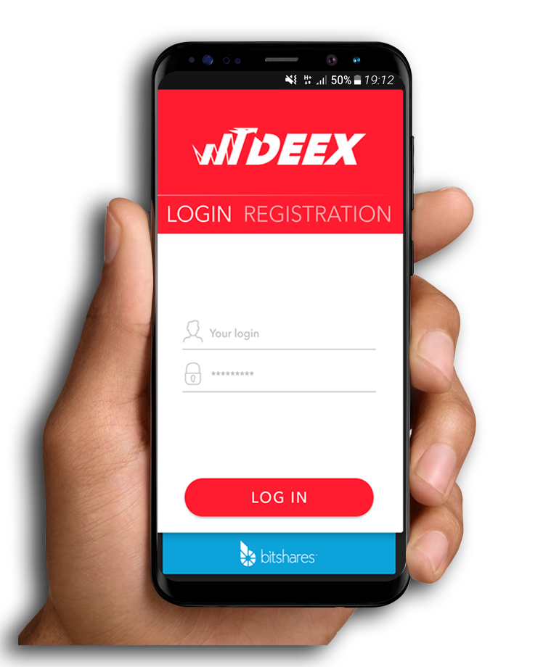
Revolutionary mobile app
Fast and reliable
In just a couple of clicks

Slide 27
WHAT IS NEXT?

Slide 28
INTEGRATION of new projects
RUNNING new ITOs
Making decentralized gateways
ITOs simple. Asset wizard

Slide 29
Deex Exchange in Telegram:
https://t.me/deexexchange

